Slide 1
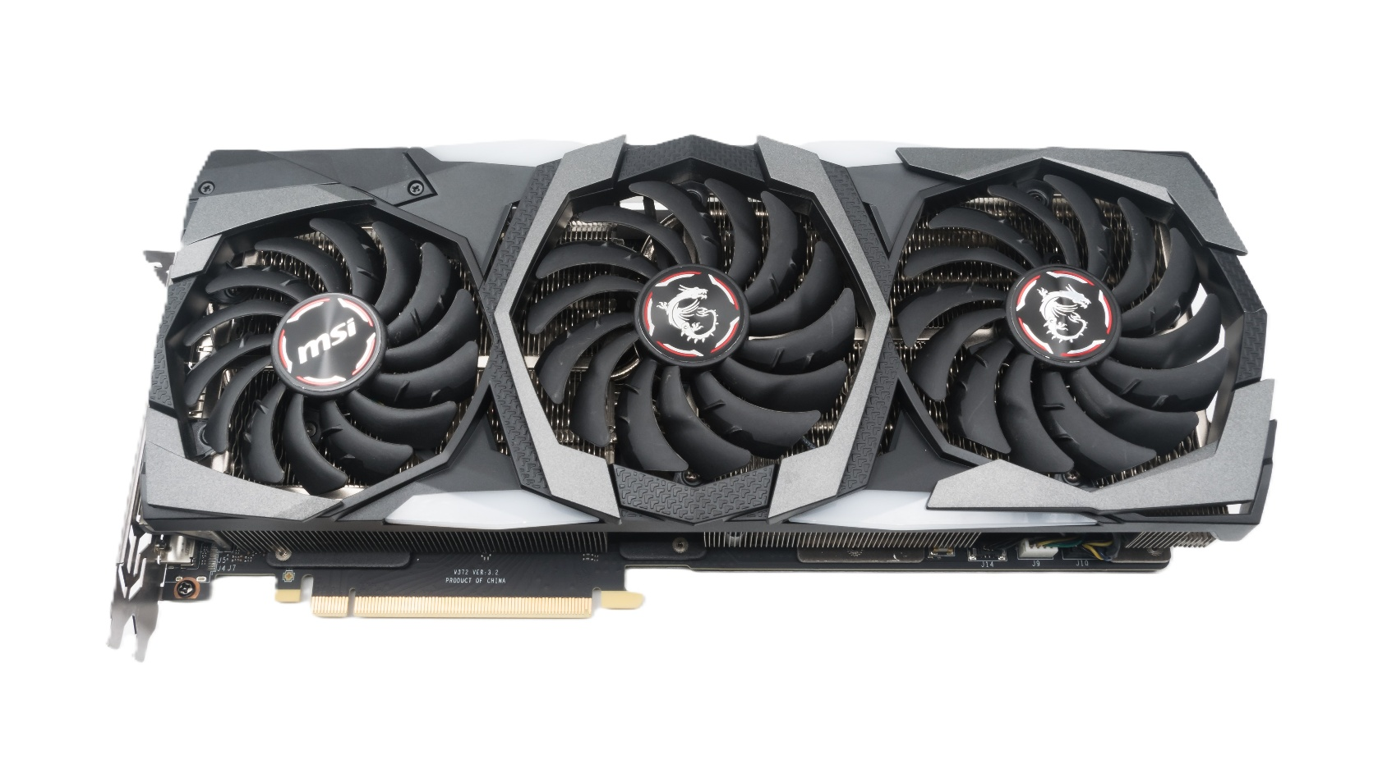


GPU-Accelerated Malware Signature Scanner​
FA22-BCS-053-A -> Muhammad Ahmad Raza
FA22-BCS-084-A -> Shehriyar Aslam
FA22-bcs-069-A -> Muhammad Zaryab Safder
FA22-BCS-157-A -> Muhammad Hasaan

Slide 2


Team Introduction

Slide 3

What is Malware Signature Scanning?
Malware scanners detect threats using known signature patterns.
Signature = sequence of bytes uniquely identifying malware.
Problem: Large signature sets + big files = slow scan times.
Goal: Accelerate scanning using GPU parallelism.

Slide 4
Methodology
Signature Parsing
File Reading
Data Preparation
GPU Memory Transfer
Convert malware signatures from hex to byte arrays, supporting wildcards.
Load the Hex content of the target file to scan.
Prepare fixed-size arrays for GPU input, including pattern masks and lengths.
Move signature and file data to GPU for parallel matching.
This step ensures all signature patterns are in a format suitable for GPU processing.
Efficient file loading ensures minimal CPU-GPU bottlenecks.
Preprocessing optimizes memory transfer and computation.
Ensures high-throughput scanning using device-level operations.

Slide 5
Algorithm
Offset-Based Scanning
Signature Matching
Atomic Result Logging
Post-Processing
Performance Logging
Each GPU thread scans from a unique byte offset in the file.
Each thread compares signatures using byte-by-byte matching (with wildcard support).
Matched results are atomically incremented in GPU memory.
Copy results back to CPU and report any detected malware signatures.
Record scan duration and kernel execution metrics for evaluation.
This achieves massive parallelism by distributing the scan across thousands of threads.
If all bytes match, the signature is considered found.
Prevents race conditions and ensures correctness in high-concurrency environments.
Final results are summarized to present detection outcomes.
Helps analyze the speedup achieved through GPU acceleration compared to serial methods.

Slide 6
Tools and Programming Language Used
Language: Python
Libraries: NumPy, Numba, json
Environment: Windows with NVIDIA GPU and CUDA toolkit
Testing Signature: EICAR (safe malware string)

Slide 7

Complexity Analysis: Serial vs Parallel
Serial
Time complexity: O(N * M * P)
N = file size
M = number of signatures
P = pattern length
Inefficient for large inputs.
Parallel ( GPU )
Launch N threads (each byte offset).
Time complexity: O(M * P), parallelized over N.
Drastically reduced runtime with 100k+ signatures.

Slide 8
Speedup
Measured 20–80× on NVIDIA GPU (depending on file & pattern size)

Slide 9

Built an efficient malware signature scanner
Leveraged GPU parallelism to scan files faster.
Supported wildcards in signatures.
Can scan thousands of signatures against large files in seconds.
Future work:
Scan multiple files concurrently.
Add behavioral detection.
GUI-based scanner.
Conclusion

Slide 10
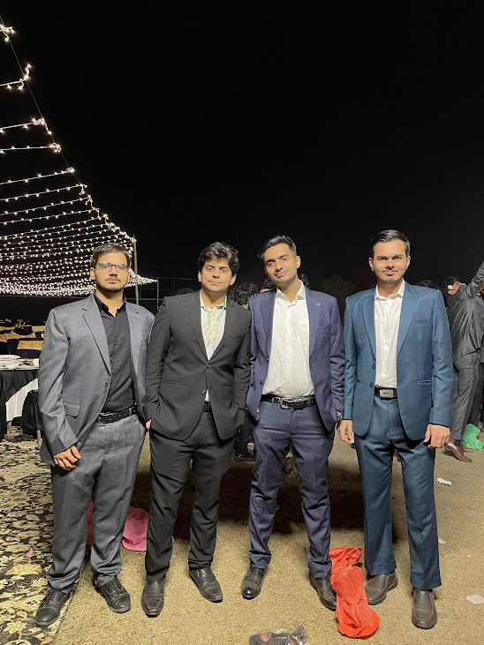
Any questions????

